Slide 1




Telecom Customer Churn Prediction
Presented by:
Name: Sandip Ramcharit Verma
PRN: 20240804044
Dr. Jagadish S Jakati
Project Guide
Dr. Swapnil Waghmare
Project Coordinator
Dr. Maheshwari Biradar
HOD, BCA&MCA

Slide 2

Content
Introduction
Block Diagram
Flowchart
Data Dictionary
Data Preprocessing
Exploratory Data Analysis (EDA)
Model Building
Model Evaluation
Conclusion
Future Work

Slide 3

Introduction
Customer churn happens when people stop using a telecom company's services, causing loss of money and more effort to get new customers. This project uses Machine Learning to study past customer data and predict who might leave. By knowing this in advance, telecom companies can offer better deals and services to keep customers happy. The goal is to build an easy-to-use and accurate model that helps companies reduce churn and improve customer satisfaction.
Problem Statement:
The aim of the project is to analyze customer demographics, services, tenure, and other variables to predict whether a particular customer will churn or not.
Objective:
Develop a predictive model to identify customers at risk of churning.
Enable telecom companies to take proactive retention measures.

Slide 4
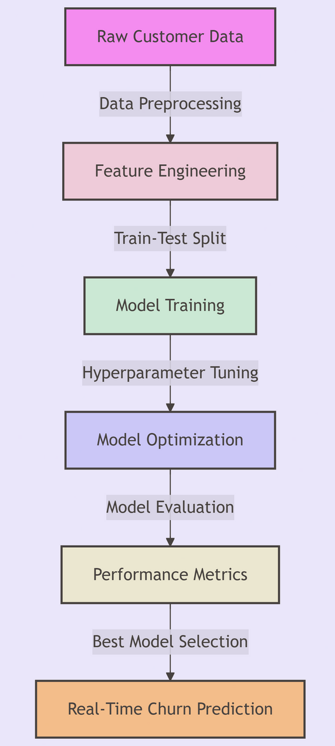
Block Diagram

Slide 5

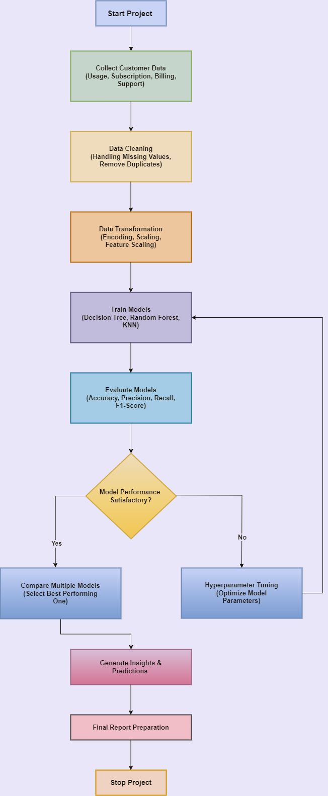
Flowchart
A
A

Slide 6
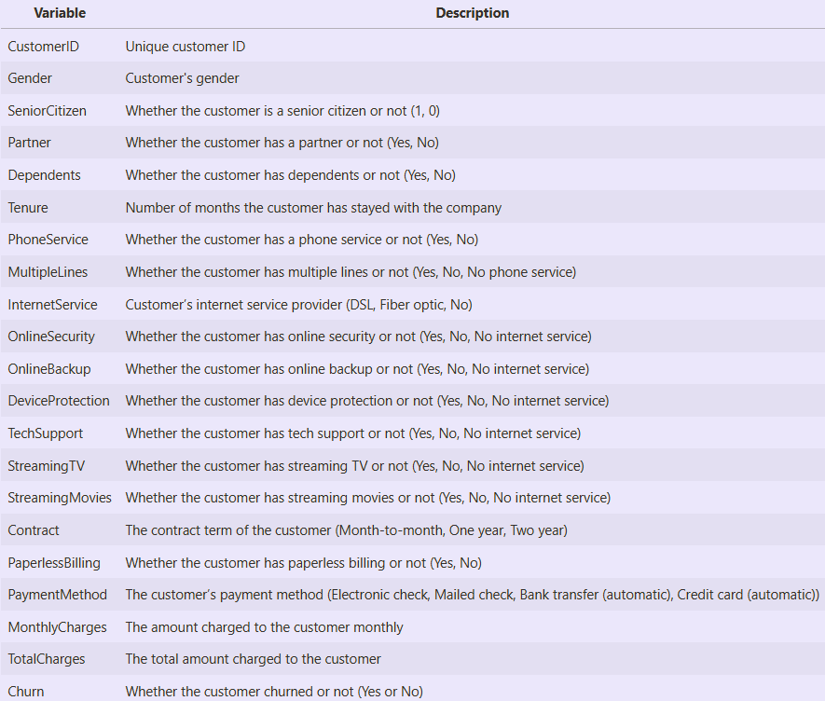
Data Dictionary

Slide 7
Data Preprocessing
Data Cleaning:
Handled missing values.
Removed duplicate entries.
Converted data types where necessary.
Feature Engineering:
Encoded categorical variables using Label Encoding and One-Hot Encoding.
Feature Scaling:
Standardized numerical features (e.g., Tenure, MonthlyCharges, TotalCharges) for better model performance.
Outlier Detection:
No significant outliers were found in the dataset.

Slide 8
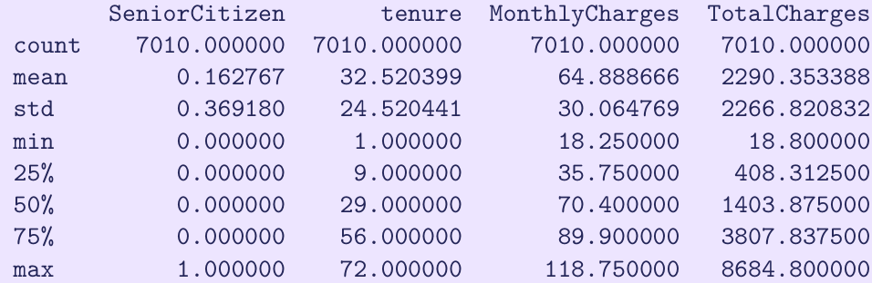
Exploratory Data Analysis (EDA)
Summary Statistics:
A quick look at the numerical features provides insights into the dataset’s structure and spread.
Key Observations:
The tenure ranges from 1 to 72 months, indicating both new and long-term customers.
The MonthlyCharges vary between $18.25 and $118.75, showing different subscription levels.
The TotalCharges column initially had missing values, which were handled earlier.

Slide 9
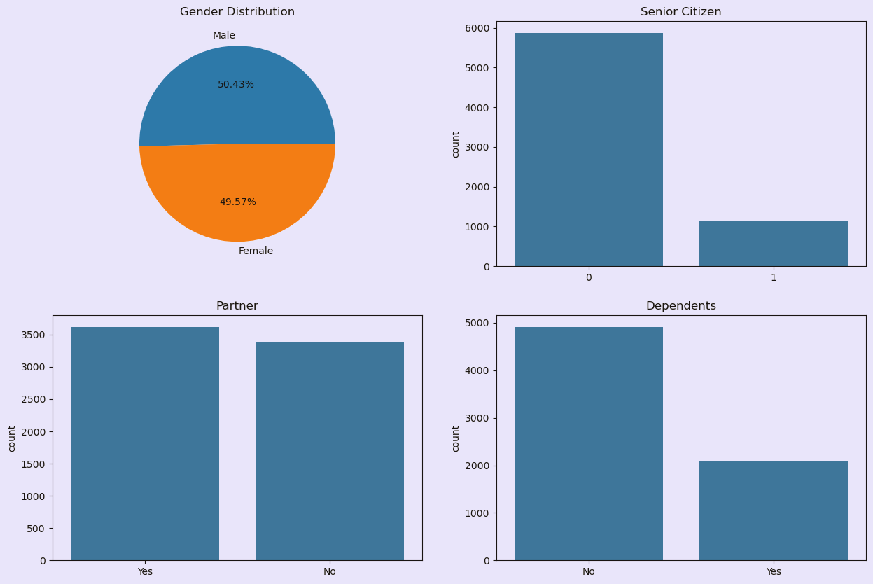
Univariate Analysis:
First, I will begin with looking at the distribution of the data and then I will look at the relationship between the independent variables and the target variable.
Customer Demographics
Gender Distribution:
Nearly equal proportion of male and female customers.
Senior Citizens:
Most customers are non-senior citizens.
Dependents & Partners:
Around 3500 customers have partners, while a similar number don't. Most customers are without dependents, though many do have them.

Slide 10
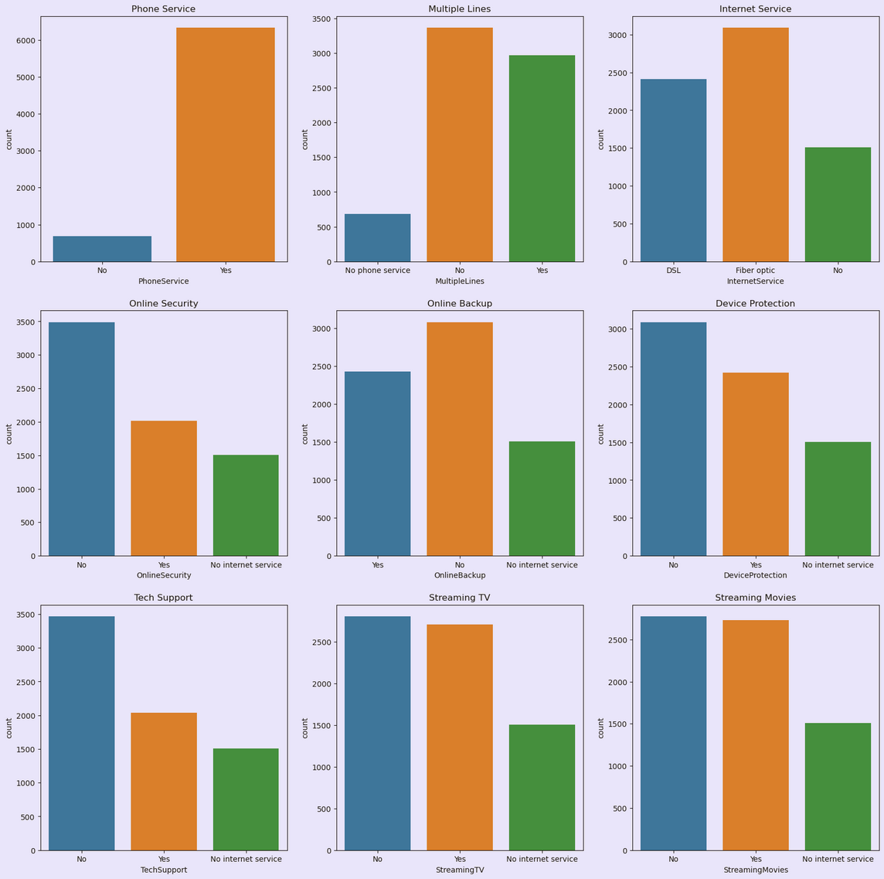
Service Usage:
Phone Services:
Around 6000 customers have subscribed, with nearly half opting for multiple lines.
Internet Services:
Approximately 5500 users, with 3000 choosing fiber optics and the rest DSL, likely for business.
Other Services:
Streaming services lead with over 2500 customers, followed by online backup and device protection (2500 users). Online security and tech support are the least chosen, with about 2000 users each.
Conclusion:
Streaming services are highly favored after phone and internet. The company should focus on enhancing these services.

Slide 11
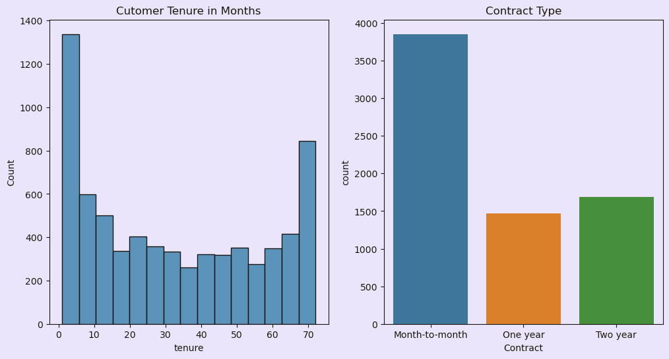
Tenure & Contract Type:
Short Tenure:
Most customers have a tenure of less than a month and opt for month-to-month contracts.
Loyal Customers:
A significant number of customers show loyalty with a tenure of around 70 months.
Two-Year Contract:
Nearly 1700 customers prefer two-year contracts, making it the second most popular option.
Other Tenure:
Remaining customers have tenure between 1-5 years.

Slide 12
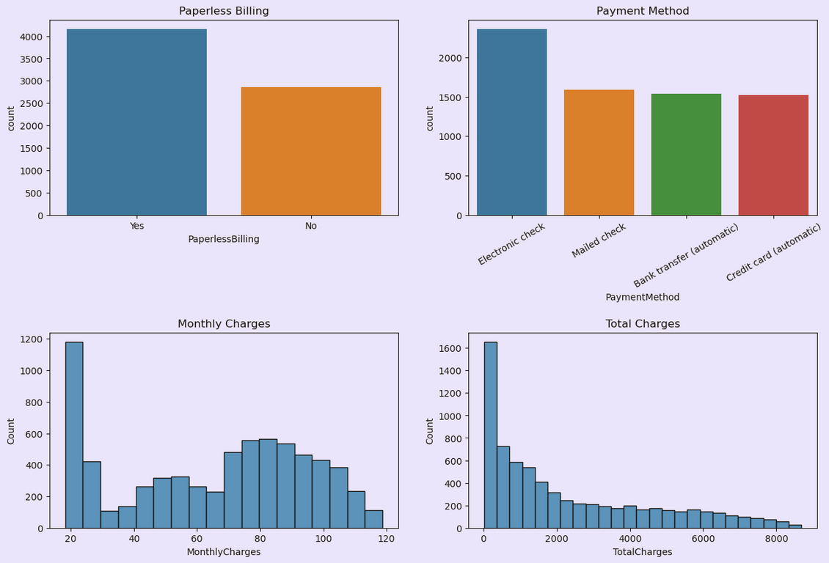
Billing and Charges:
Billing Methods:
Around 4000 customers prefer paperless billing.
Over half of them pay through electronic checks.
Paper bills and other payment methods (mailed checks, bank transfers, credit cards) are chosen by nearly 4500 customers altogether.
Monthly Charges:
Many customers pay around $20 monthly, with most having total charges below $2000.
Some customers have monthly charges between $70–$110.
Total Charges:
A few customers have bills exceeding $4000 or even $8000, likely due to long tenure or high service usage.
Conclusion:
Most customers prefer lower charges, so the company should focus on offering more affordable services.

Slide 13
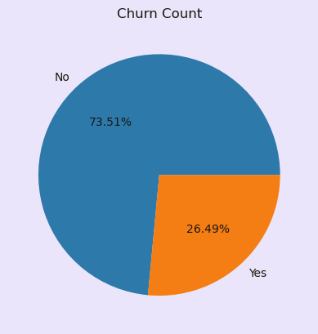
Churn Count:
The number of churning customers is significantly lower compared to non-churning customers.
Only 26.49% of customers have churned from the telecom company.
This indicates the company is effective at retaining its customers.

Slide 14
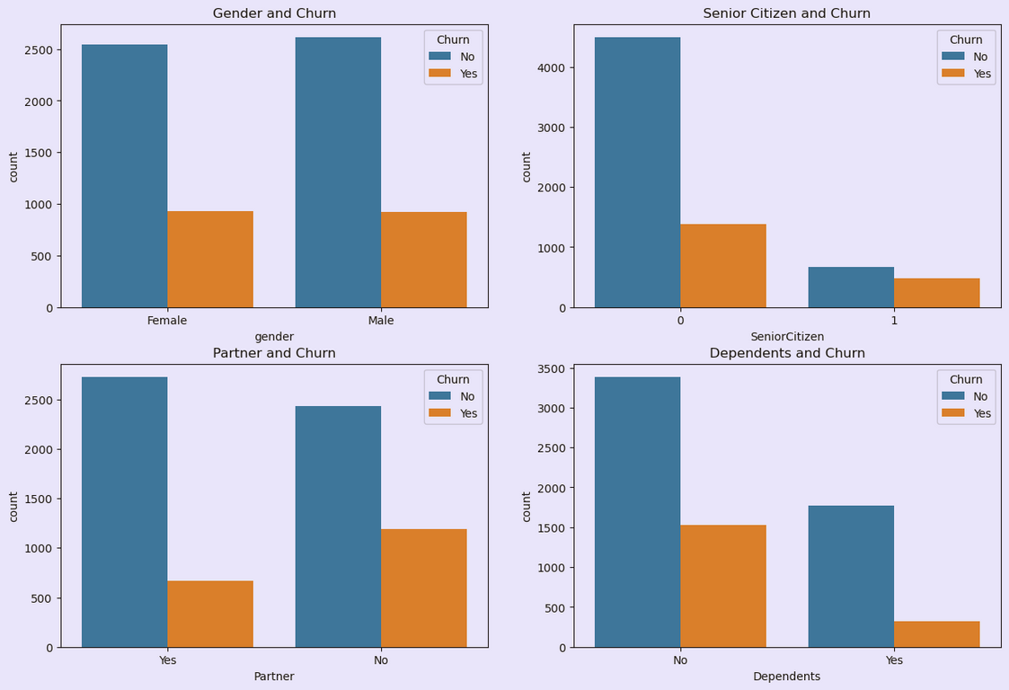
Bivariate Analysis:
Till now, I have visualized the data and got a better understanding of the data. Now, I will look at the relationship between the independent variables and the target variable.
Customer Demographics and Churn
Gender:
Churn count is equal for males and females, indicating no relation between gender and customer churn.
Senior Citizens:
Have lower churn rates compared to non-senior citizens, possibly due to their unwillingness to switch companies.
No Partners:
Customers without partners show higher churn rates compared to those with partners.
No Dependents:
Customers without dependents also have higher churn rates than those with dependents.
Conclusion:
Single customers with no partners or no dependents are more likely to churn, while senior citizens are less likely to leave.

Slide 15
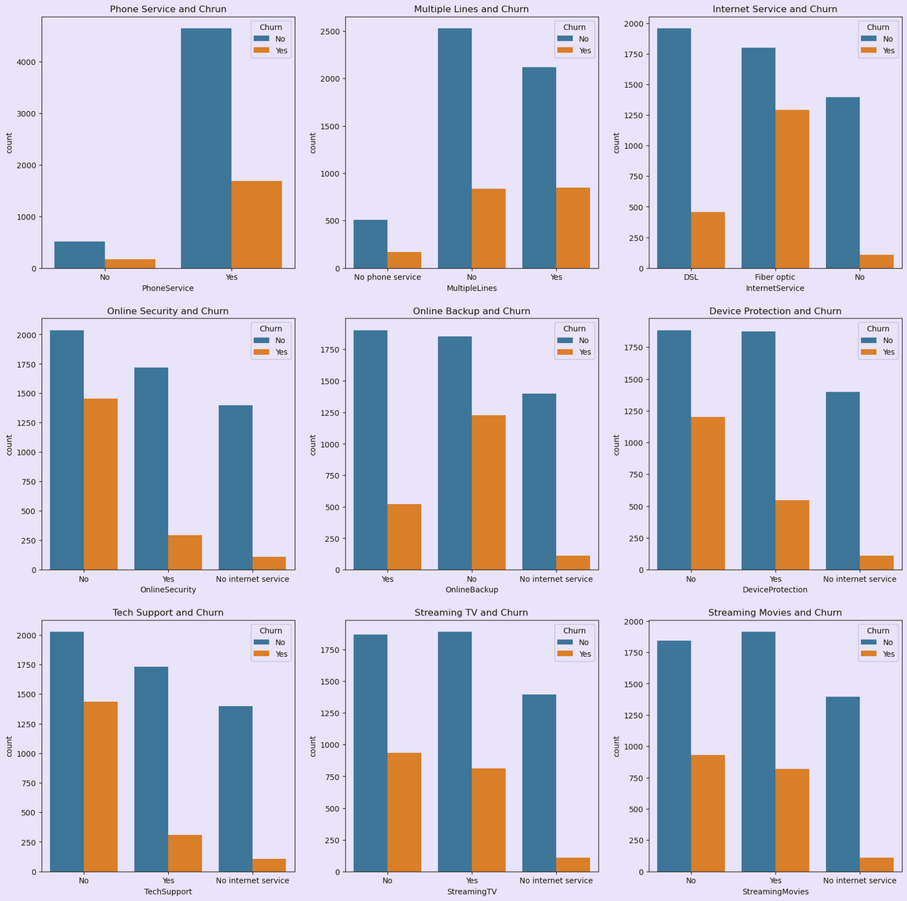
Services and Churn:
Phone and Internet Services:
No relation between churn and service opted, but churn is higher for customers with multiple lines.
Online Backup and Device Protection:
Higher churn count for customers who haven’t opted for these services.
Streaming Services:
Customers with streaming services have lower churn rates.
Conclusion:
Customer churn is influenced by multiple lines, Online Backup, Device Protection, and Streaming Services.

Slide 16
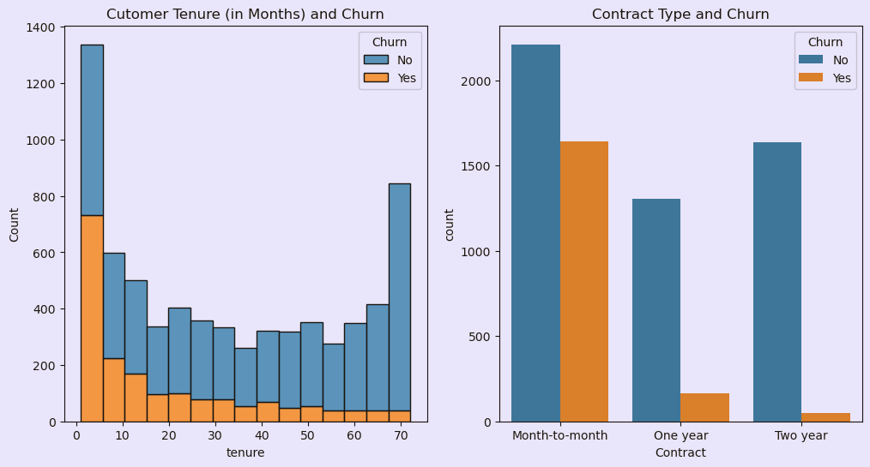
Tenure/Contract and Churn:
Tenure and Churn:
Customers with shorter tenure (less than 5 months) have higher churn count. Churn decreases as tenure increases.
Contract and Churn:
Customers with month-to-month contracts have higher churn rates compared to those with one or two-year contracts.
Conclusion:
Longer contracts and extended tenure correlate with lower churn rates.

Slide 17
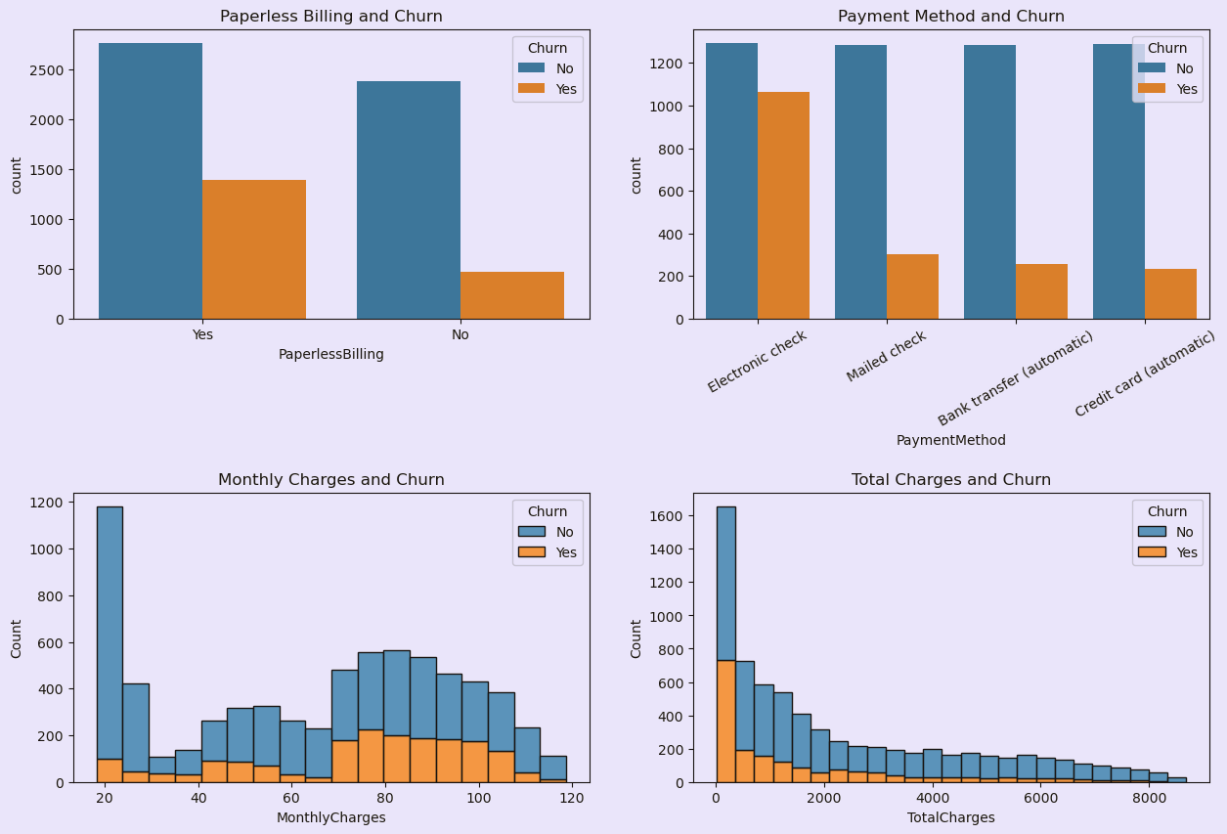
Billing/Charges and Churn:
Billing and Payment Method:
No significant relation with customer churn.
Monthly Charges:
Customers with higher monthly charges show higher churn count.
Total Charges:
Higher total charges correlate with lower churn count, likely due to long tenure or extensive service use.
Recommendation:
Lower monthly charges to reduce customer churn effectively.

Slide 18
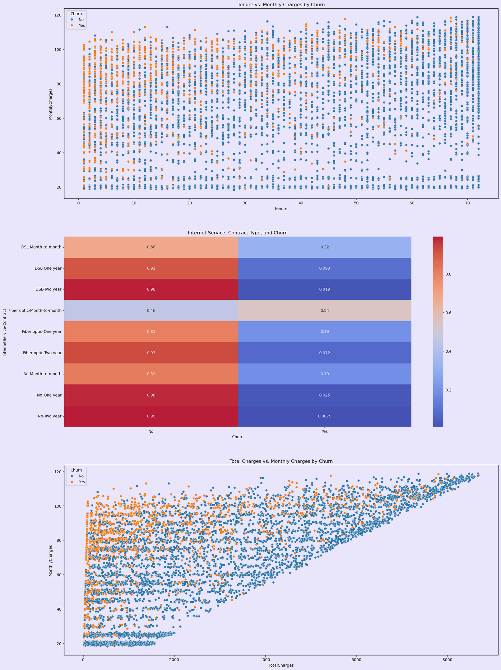
Multivariate Analysis:
Till now, I have analyzed the relationships between independent variables and the target variable individually. Now, I will examine how multiple independent variables interact with each other and their combined effect on the target variable.
Tenure Vs. Monthly Charges by Churn
High Churn Rate:
Customers with shorter tenure and higher monthly charges show a higher churn rate (visible as more orange points in the scatter plot).
Low Churn Rate:
Customers with longer tenure and lower monthly charges exhibit a lower churn rate, suggesting they are more likely to remain with the company.

Slide 19
Internet Service, Contract Type, and Churn:
High Churn Rate:
Customers on month-to-month contracts, particularly with Fiber optic internet, show significantly higher churn rates.
Low Churn Rate:
Customers with one-year or two-year contracts have notably lower churn rates.
Conclusion:
Longer contract durations help in reducing customer churn.

Slide 20

Total Charges vs. Monthly Charges by Churn:
High Monthly Charges:
Customers with high monthly charges have a higher churn rate.
High Total Charges:
Customers with high total charges, likely due to long tenure, have lower churn rates.
Conclusion:
Long-term customers with high total charges are more loyal, while new customers with high monthly charges are at greater risk of leaving.

Slide 21
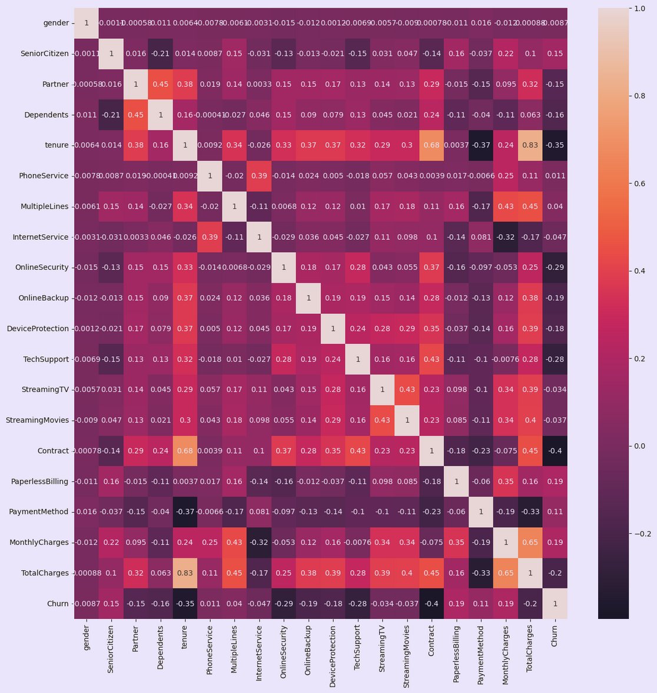
Correlation Matrix Heatmap:
Tenure and Contracts:
Longer tenure and long-term contracts reduce churn, while month-to-month contracts increase it.
Monthly and Total Charges:
Higher monthly charges slightly increase churn, but customers with higher total charges (due to long tenure or additional services) are more loyal.
Recommendation:
Focus on promoting long-term contracts, and managing monthly charges to reduce churn.

Slide 22

Model Building
Balancing the Data:
Churn
0 5153
1 1857
Used SMOTE (Synthetic Minority Over-sampling Technique) to balance the dataset so the model learns better.
Machine Learning Models Used:
Decision Tree Classifier:
Splits the data into branches based on customer details.
Random Forest Classifier:
Uses multiple decision trees to improve accuracy.
K-Nearest Neighbors (KNN) Classifier:
A distance-based algorithm that predicts churn by finding similar customers in the dataset.
Hyperparameter Tuning:
Applied GridSearchCV to find the best parameters for each model, improving performance.

Slide 23
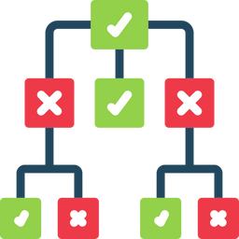
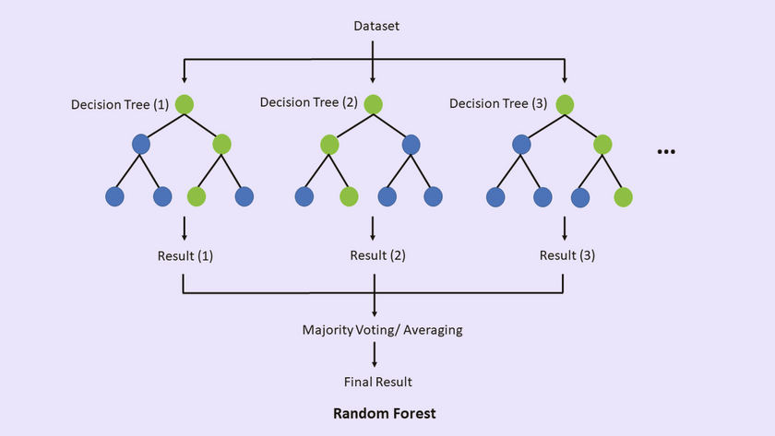
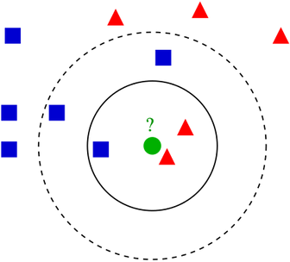
Model Evaluation
Performance Results:
Decision Tree:
Training Accuracy: 81.07%
Testing Accuracy: 75.39%
Random Forest:
Training Accuracy: 87.06%
Testing Accuracy: 78.1%
KNN:
Training Accuracy: 86.71%
Testing Accuracy: 74.54%
Best Model:
Random Forest performed the best because it had the highest testing accuracy.

Slide 24

Conclusion
Key Findings:
Customers with shorter tenure, higher monthly charges, and no dependents are more likely to leave.
Customers with long-term contracts and lower monthly charges are less likely to leave.
Recommendations for Telecom Companies:
Offer discounts on monthly charges and long-term contracts to reduce churn.
Improve customer support and engagement to keep customers happy.
Provide better streaming and device protection services to add value.

Slide 25

Future Work
Possible Improvements:
Try advanced models for better accuracy:
XGBoost:
A powerful gradient boosting algorithm that improves performance by combining multiple weak models.
SVM (Support Vector Machine):
A classification algorithm that finds the best boundary to separate churn and non-churn customers.
Logistic Regression:
A simple yet effective algorithm for binary classification, predicting churn probability.
Calculate evaluation metrics:
Accuracy:
Measures the overall correctness of predictions.
Precision:
Shows how many predicted churn cases were actually correct.
Recall:
Measures how well the model identifies actual churn cases.
F1-score:
A balance between precision and recall, useful for imbalanced data.
Make predictions to classify new customers as churn or not churn.

Slide 26
Thank
You.

